Slide 1


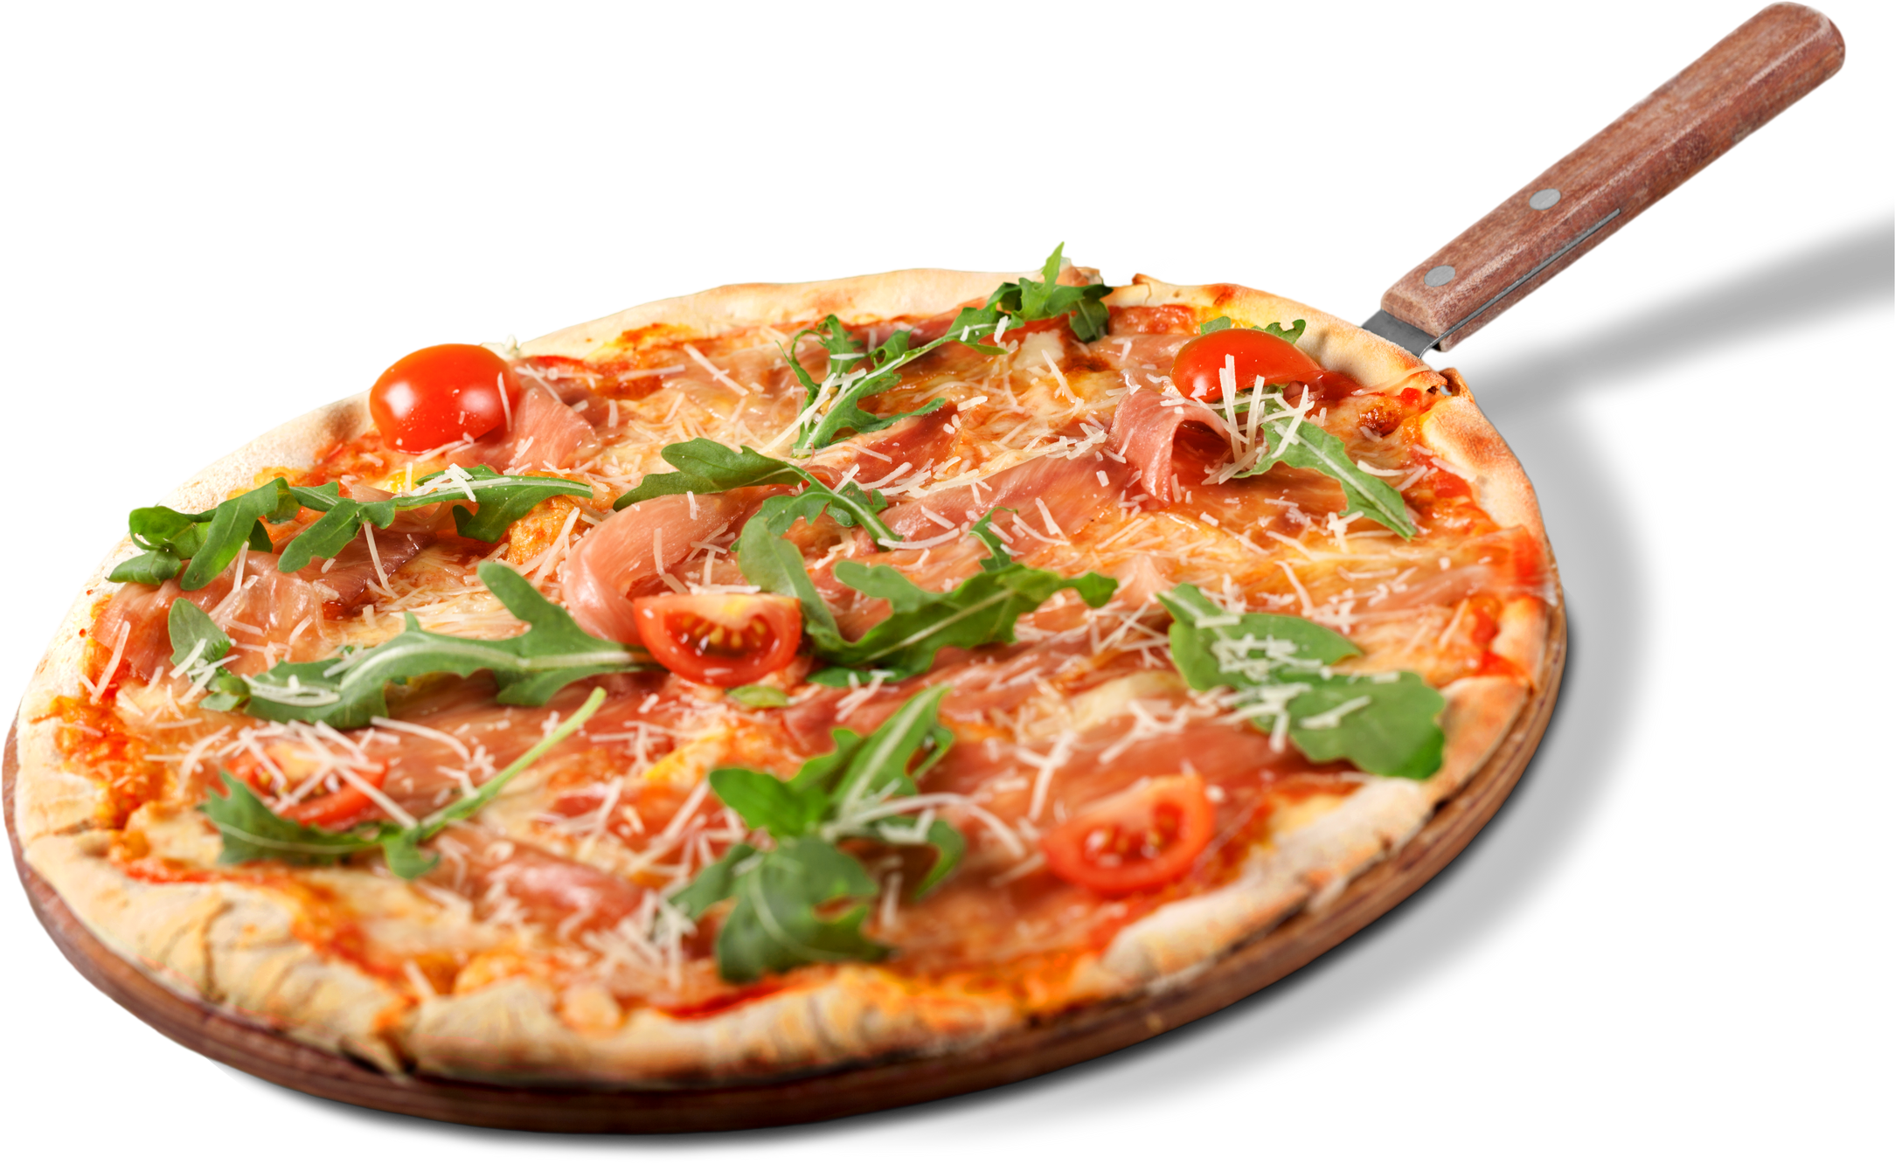





HOW TO MAKE
Simple Recipes
Pizza & Pizza Dough

Slide 2





PREPARATION
SERVINGS
"
The pizza dough recipe makes enough dough for two 10-12 inch pizzas.
4 to 6 servings
YIELD
2 10-inch pizzas
PREP TIME
COOK TIME
TOTAL TIME
2 hrs
30 mins
2 hrs 30 mins

Slide 3

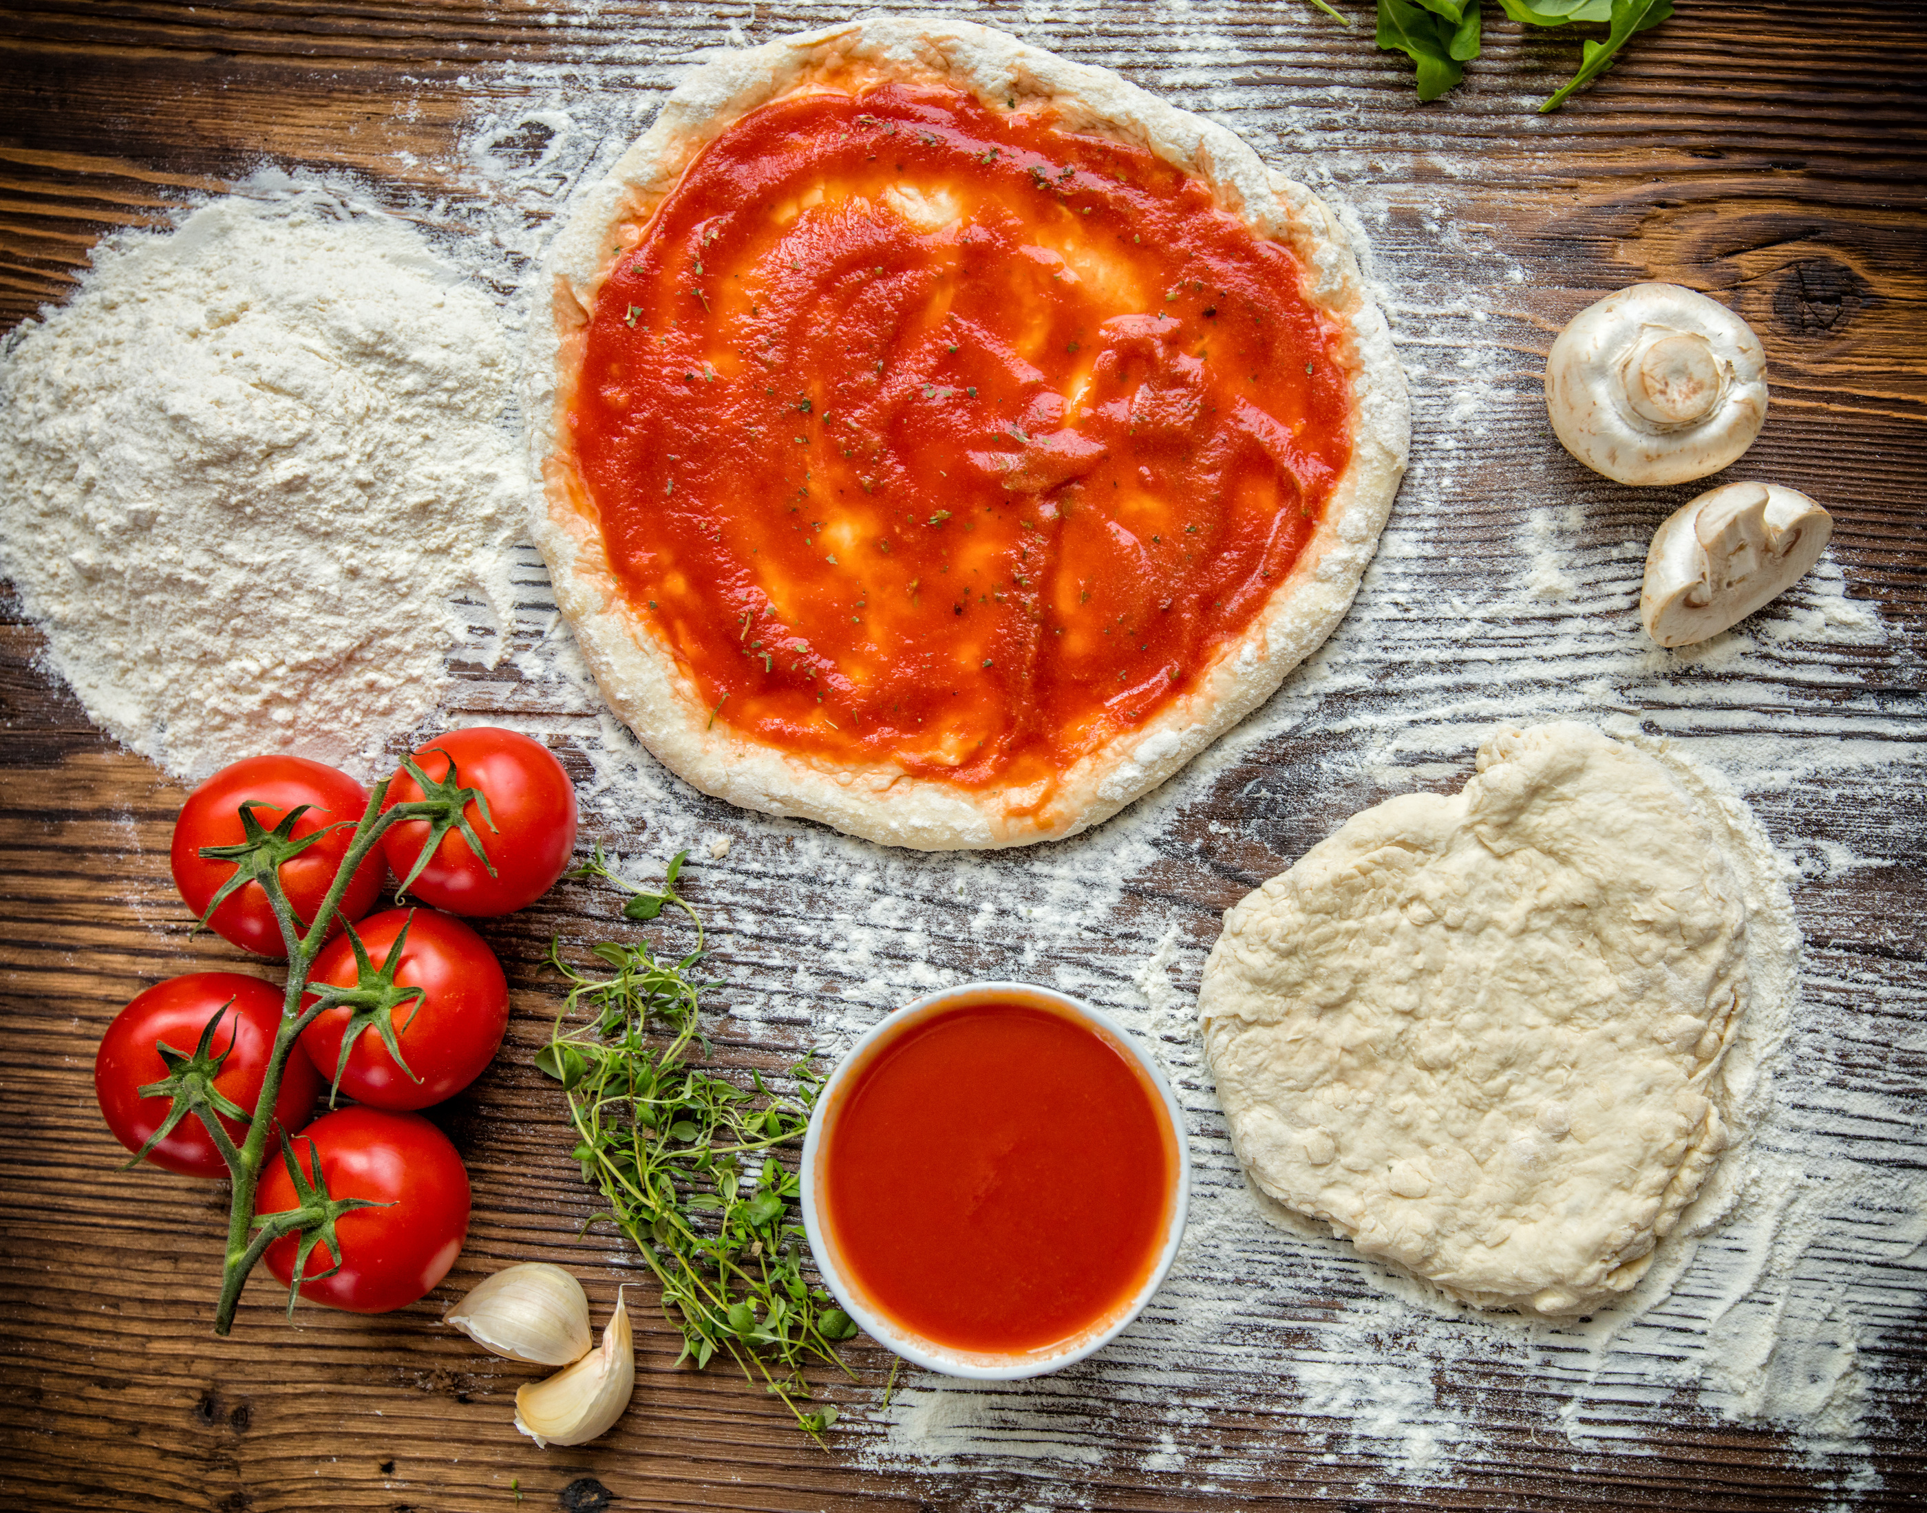





INGREDIENTS
PIZZA DOUGH
2 1⁄2 cups flour
1 teaspoon salt
1 teaspoon sugar
1 tablespoon fast rise yeast
1 cup warm water
1 tablespoon oil

Slide 4




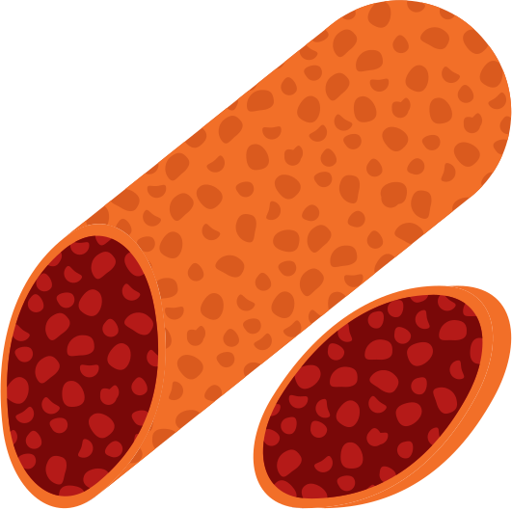




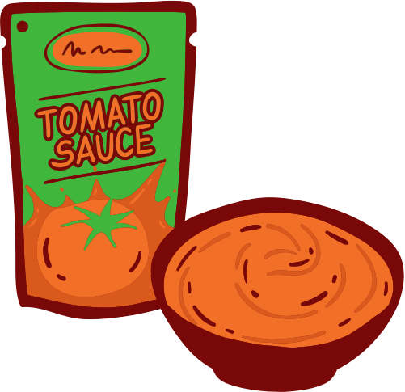
INGREDIENTS
PIZZA TOPPING
YUMMY
1 cup shredded mozzarella cheese
1 cup shredded monterrey jack cheese
3 tablespoons grated parmesan cheese
1⁄2 teaspoon salt
1 1⁄2 cups pepperoni slices
1⁄8 teaspoon pepper
CHEESE
1⁄4 cup tomato sauce
1⁄2 teaspoon garlic powder

Slide 5



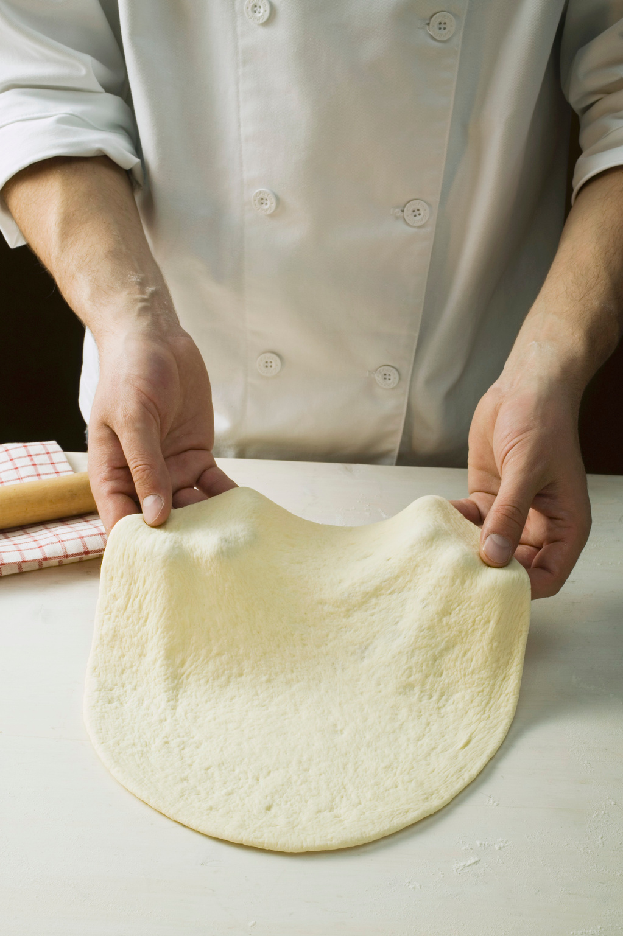


DIRECTION
PIZZA DOUGH
In a large bowl, mix water, flour, and oil
Add to flour mixture, turn into the floured surface; knead for 2 minutes.
Place in a greased bowl; turning to grease top. Cover and let rise for 20 minutes.
Punch down; place on 12in, greased pizza pan. Pat into a circle.

Slide 6

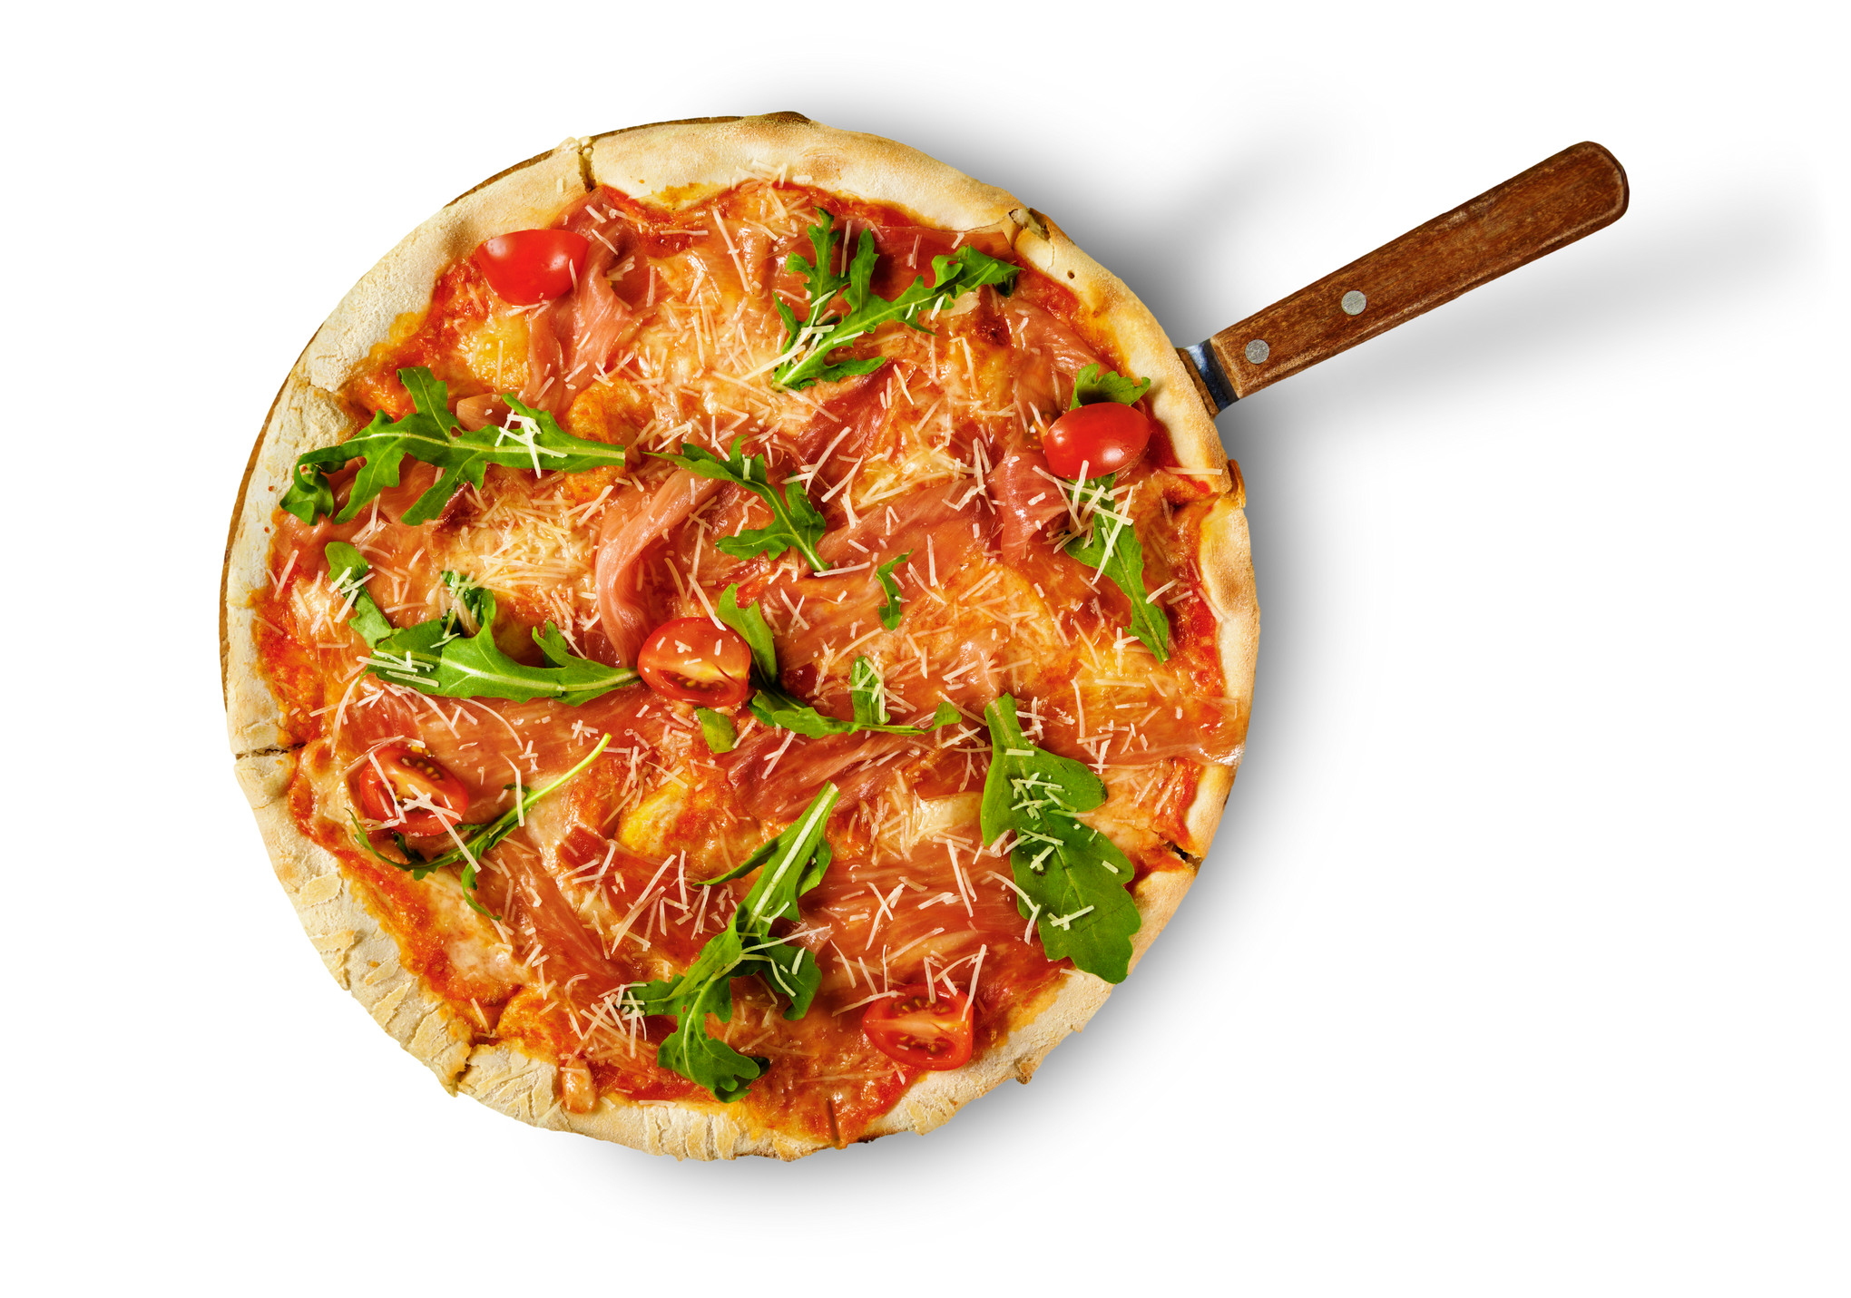
DIRECTION
PIZZA TOPPING
Mix tomato sauce, garlic powder, salt, and pepper.
Put a few pepperoni slices on top of the sauce.
Sprinkle with 1/2 the mozzarella; 1/2 the Monterey jack, and 1/2 the parmesan.
Put the rest of the pepperoni on.
Repeat the cheese layer.
Bake at 400* for 20 minutes or until light brown.

Slide 7






TESTIMONIALS
So good! The crust is perfect! The only thing I did differently was to put a bit of olive oil in my pizza pan before putting the dough on it.
this is great! I made this pizza and added mushrooms instead of pepperoni and it was really good 10/10

Slide 8

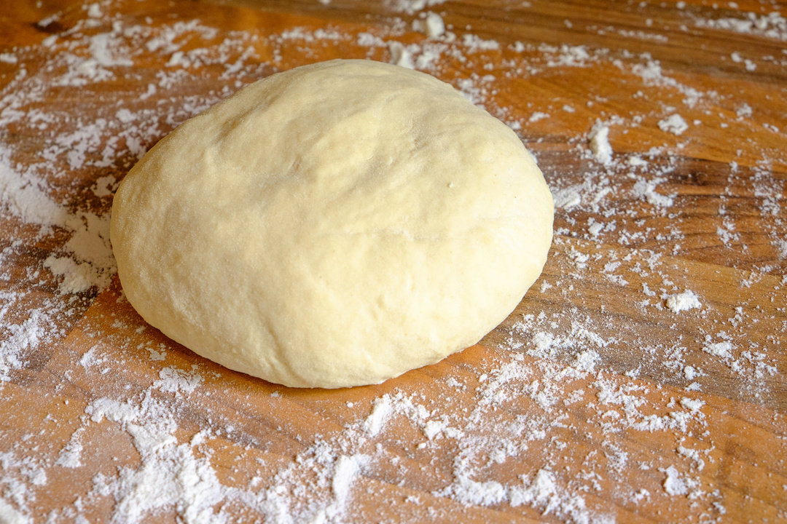
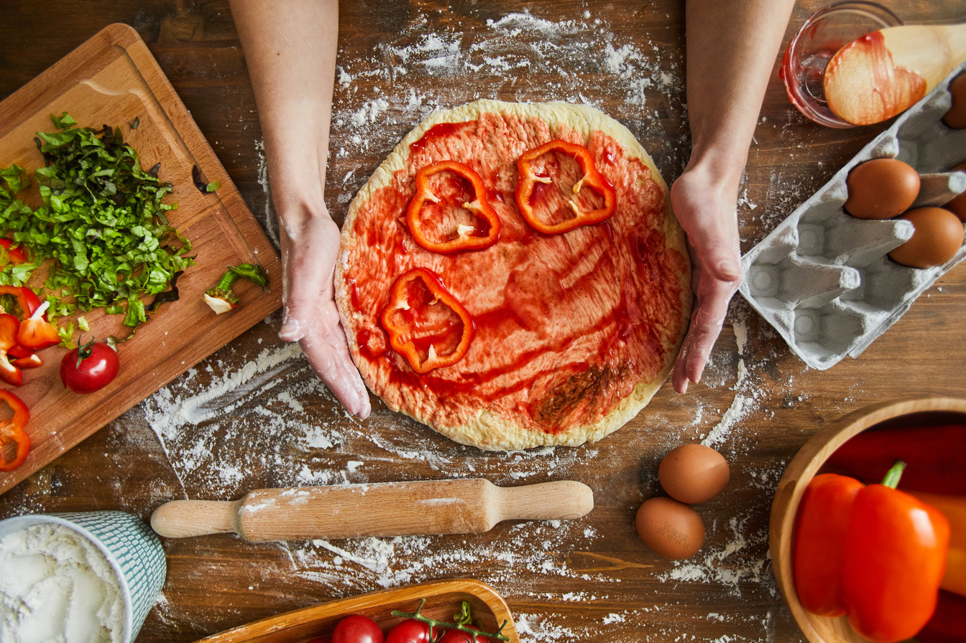
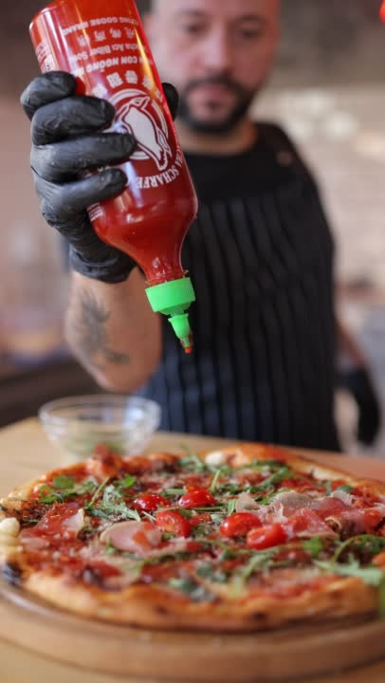

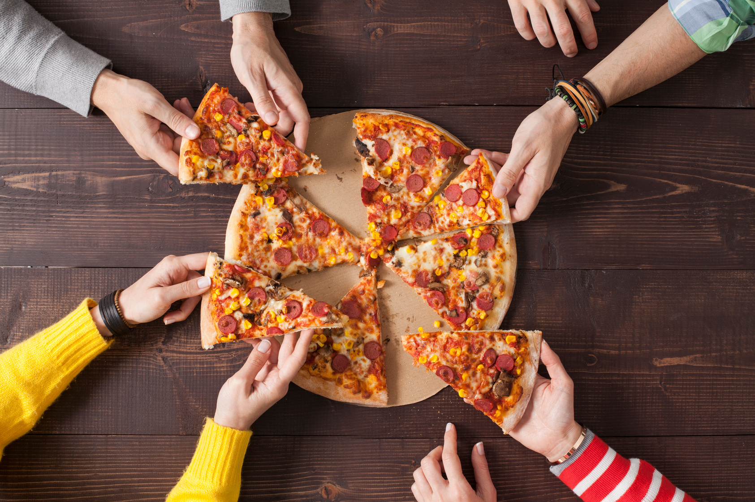
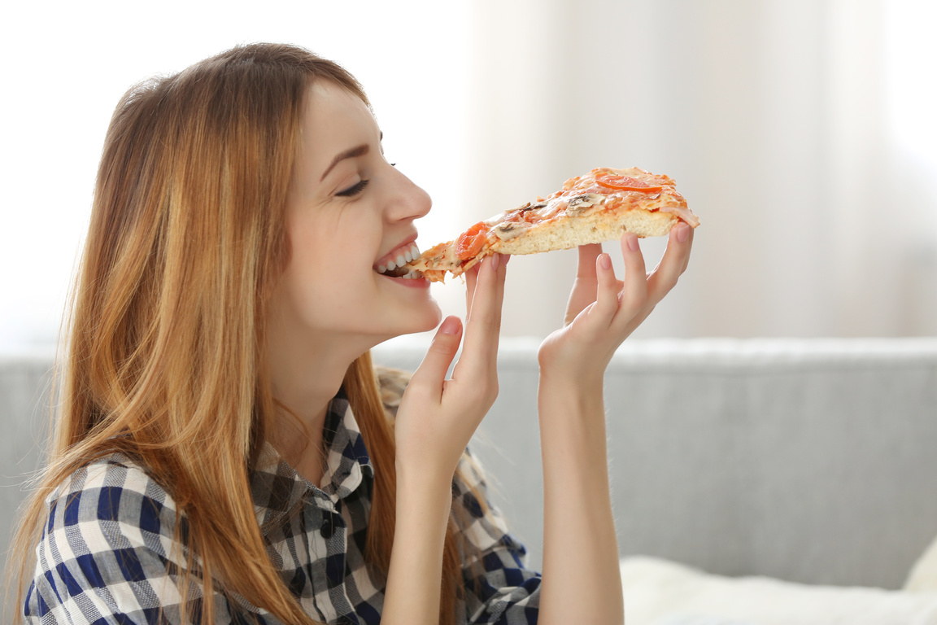

GALLERY
Delizioso !!!

Slide 9






NUTRITION FACTS
AMOUNT PER SERVING
Cholesterol 0mg 0%
Sodium 710mg 31%
Dietary Fiber 2g 8%
Total Sugars 1g
Vitamin C 0mg 0%
Calcium 15mg 1%
Iron 1mg 4%
Potassium 96mg 2%
322
61 g
Calories
Carbs
4 g
10 g
Fat
Protein

Slide 10


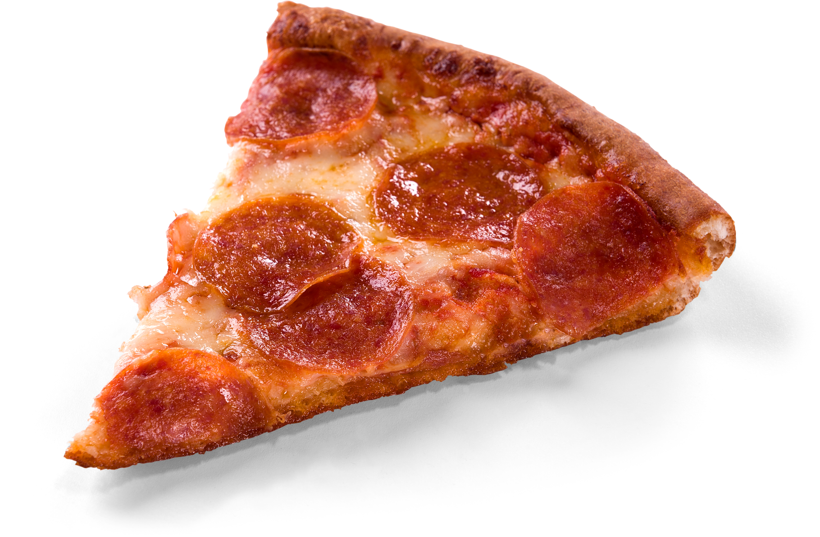


THANK YOU !!!
So Yummy!
Try at home!
Pizza Recipes

